Slide 1

Efficient Selective-ID Secure Identity-Based Encryption Without Random Oracles
Group 6

Slide 2
1
Introduction
2
Preliminaries and Complexity Assumptions
3

Slide 3
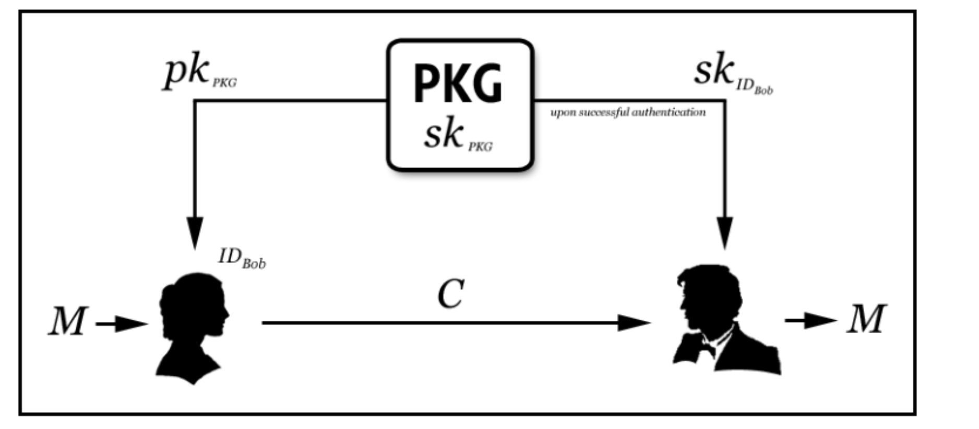
1
Introduction
Identity-based encryption allows parties to use the recipient's ID as a public key to encrypt messages. The ability to use your ID as your public key eliminates the need to distribute your public key certificate.
This is very useful in applications such as email where the recipient is often offline and the sender cannot present the public key certificate while the message is encrypted.
Notes:
身份加密（IBE）的出现：基于身份的加密允许各方使用收件人的ID作为公钥来加密消息。使用ID作为公钥的能力消除了分发公钥证书的需要。这在电子邮件等应用程序中非常有用，在这些应用程序中，收件人通常是脱机的，而发件人在消息被加密时无法提供公钥证书。

Slide 4
1
Introduction
The first efficient and secure method of Identity-Based Encryption was published by Boneh and Franklin. They have proposed a solution that uses an efficiently computable bilinear map that has been shown to be safe in a random oracle model.
Since then, there are schemes that have been shown to be secure without a random oracle, but a weaker security model known as the selective identity model. Most recently, Boneh and Boyen described a scheme that proved to be completely safe without random oracles. The possibility of such a plan was an open issue up to that point. However, those schemes are too inefficient to be practical.
[1] Dan B , Franklin M . Identity-Based Encryption from the Weil Pairing. Annual International Cryptology Conference. Springer, Berlin, Heidelberg, 2001.
Notes:
2001 年，Boneh 和 Franklin给出了第一个实用的基于身份的加密方案，该方案基于椭圆曲线上的双线性配对群。在文章中，他们证明了这个方案在随机预言机模型下是满足 IND-CPA 安全的，并且通过 Fujisaki-Okamoto的通用转换，这个方案可以达到 IND-CCA 安全。由于这个方案的安全证明是在随机预言机模型下进行的，随机预言机是一种过于理想的假设，要求敌手不利用散列函数的弱点（在现实中，散列函数是确定的， 其输出并不能保证是完全随 机且均匀分布的）来对方案进行攻击。因此在随机预言机模型下安全的一些方案，在使用真实的散列函数之后，就不再安全了。所以该方案在现实中的安全性并不能得到保证。
其后 Boneh 和 Boyen在2004年，同样是基于标准模型构造了两个效率更高的 IBE 方案。

Slide 5
Efficient Selective-ID Secure Identity-Based Encryption Without Random Oracles
Group 6

Slide 6
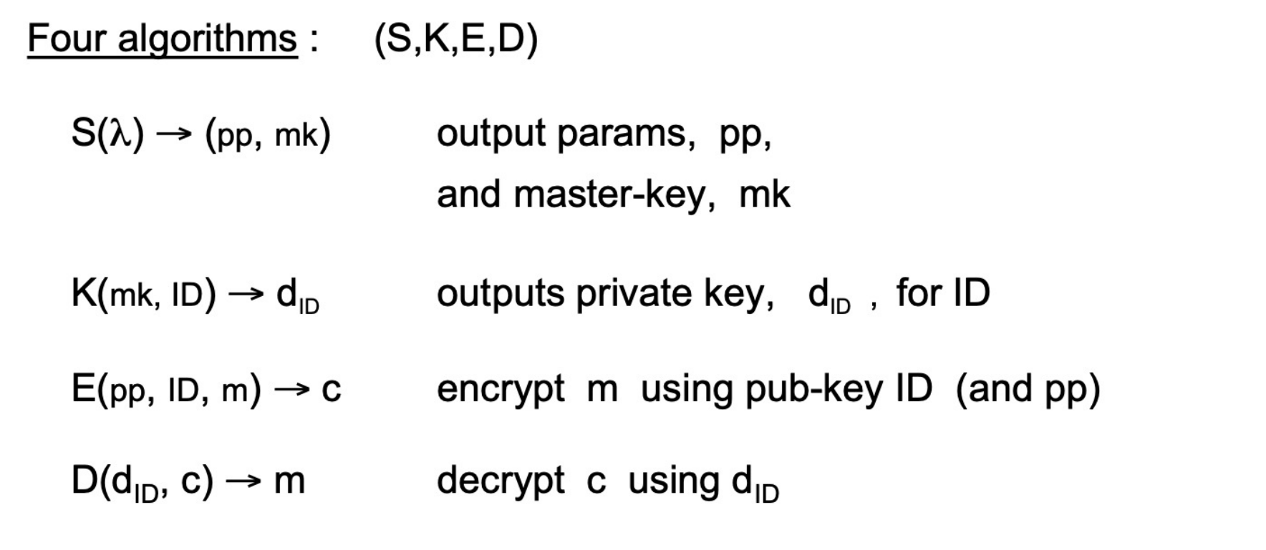
2
Preliminaries and Complexity Assumptions
Introduction
· IBE
· Bilinear Groups
An identity-based encryption system (IBE) consists of four algorithms:
Setup
KeyGen
Encrypt
Decrypt
Notes:
基于身份的加密系统 (IBE) 由四种算法组成：配置、密钥生成、加密和解密。
配置算法生成系统参数（由 params 表示）和主密钥。
KeyGen 算法使用主密钥生成与特定 ID 对应的私钥。
加密算法（使用系统参数）使用特定的 ID 对消息进行加密，
解密算法使用私钥对密文进行解密。

Slide 7
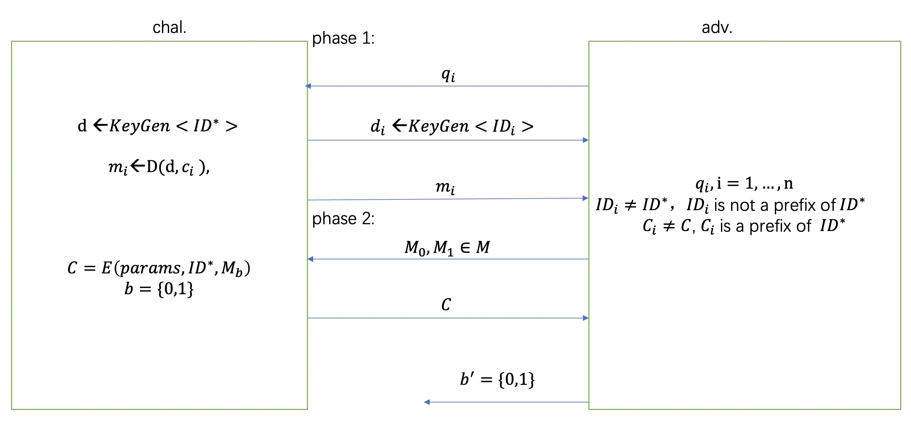
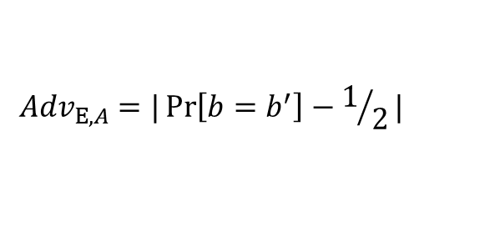
2
Preliminaries and Complexity Assumptions
adv.
$${Adv}_{Ε,A}=|\operatorname{Pr}\left[b=b^{′}\right]−1/2|$$

Slide 8
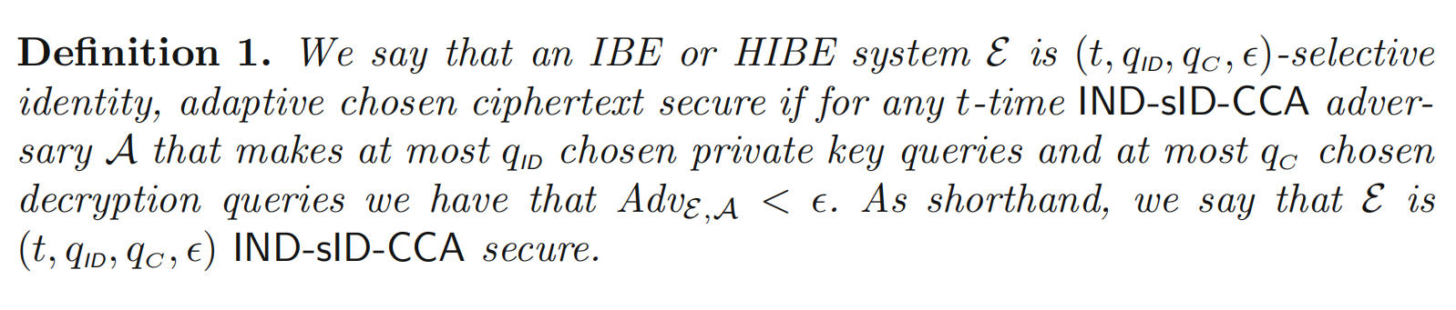
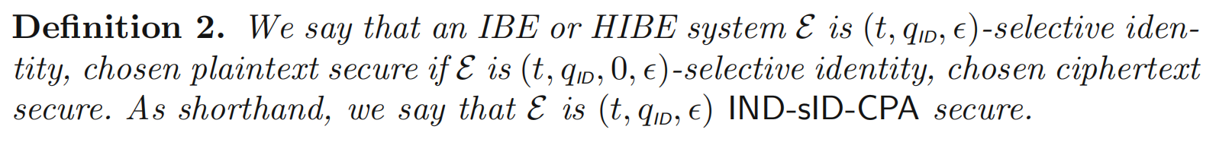
2
Preliminaries and Complexity Assumptions
Preliminaries
· Security Definitions
Definition 1 (IBE Semantic Security). Identity-based cryptographic schemes (t, q,) are semantically secure if an attacker of all t hours executing up to q private key queries can break the scheme up to.

Slide 9
2
Preliminaries and Complexity Assumptions
Preliminaries
· Bilinear Groups
1. G and G1 are two (multiplication) cyclic groups of prime order p.
2. g is the generator of G.
3. e is a bilinear map e: G × G → G1.
Let G and G1 be two groups as above. A bilinear map is a map e: G × G → G1 with the following properties:
1. Bilinear: For all u, v ∈ G and a, b ∈ Z, there is e (uª, v^{b}) = e (u, v) ^{ab}.
2. Non-degenerate: e (g, g) = 1.
3. e(u,v) is efficiently calculated algorithm . u, v ∈ G
If there is a bilinear map e: G × G → G1 that can efficiently calculate the group action of G and can be efficiently calculated with the group G1 as described above, then G is said to be a bilinear group. Note that e (,) is symmetric because e (gª, g^{b}) = e (g, g) ^{ab} = e (g^{b}, gª).

Slide 10
2
Preliminaries and Complexity Assumptions
Preliminaries
· Complexity Assumptions
Bilinear Diffie-Hellman Assumption （BDH）
Def: BDH assumption
G: finite cyclic group of order p
e: map
g: the generator of G
Suppose algorithm A is used to solve the CBDH problem, and its advantage is defined as τ
Pr| [A(g , gª, g^{b}, g^{c})] = e ( g , g ) ^{abc} | ≥ τ
Suppose algorithm B is used to solve the DBDH problem, and its advantage is defined as τ
｜Pr[B(g , gª, g^{b}, g^{c}, e ( g , g ) ^{abc})=0]-Pr[B(g , gª, g^{b}, g^{c},T)] | ≥ τ

Slide 11
Thank you
Group 6

